Slide 2
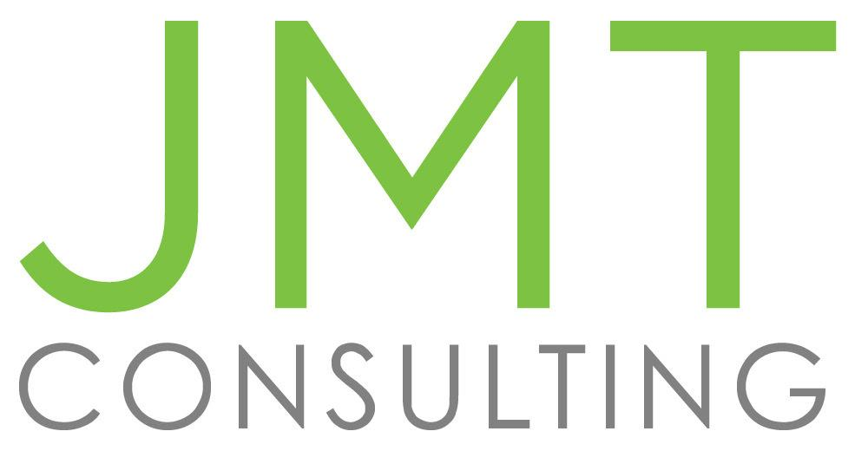
Axiom, Powered by JMT Consulting
JMT Consulting was founded in 1991
Over 30 years experience in helping organizations through optimized systems and processes
JMT acquired Axiom in 2020 to better serve cemetery industry
Passionate about modern solutions

Slide 3
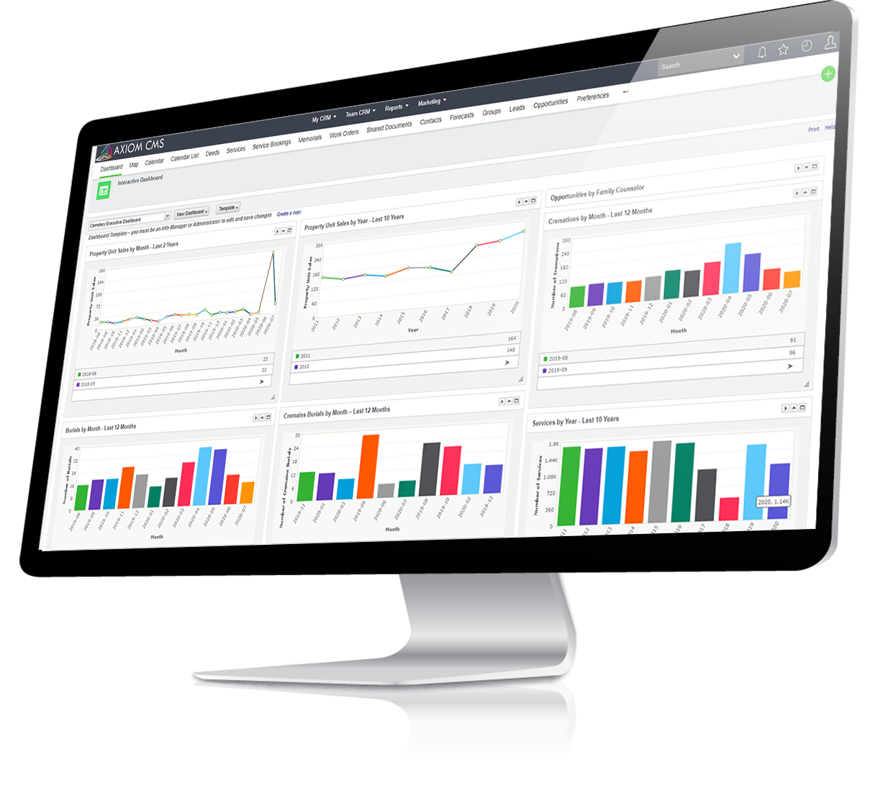
End-to-End Solution
Integrated solution
One solution for mapping, finance, record management, consumer relationship management (CRM) and more!

Slide 4
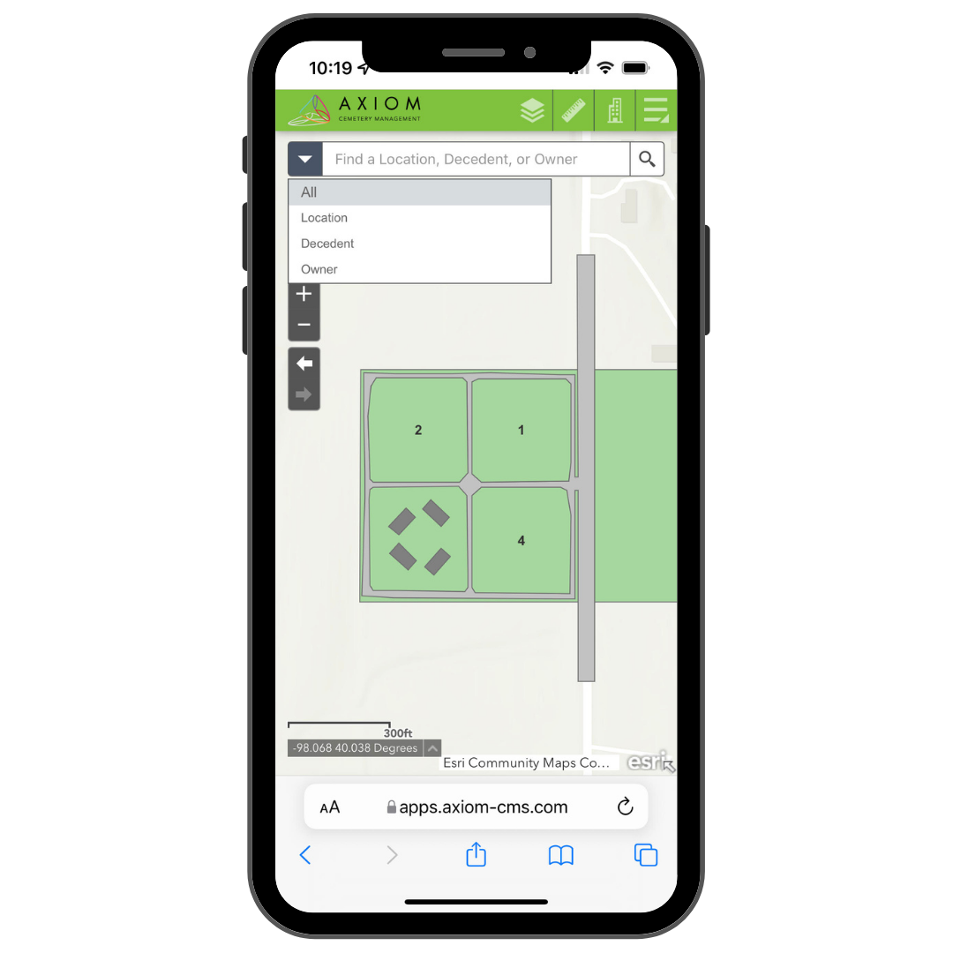
Axiom Mapping Advantage
Designed with smaller cemeteries in mind
Simple, easy-to-use online map
Cemetery information available anytime, anywhere
Up-to-date data

