Slide 1
Powerful Visualization Solutions
Operations | Management | Sales
This document and the information thereon is the property of Behar Mapping LLC and may only be used for the purpose for which it is supplied. This information and this document may not be used without the express authorization of Behar Mapping LLC. Any unauthorized use or disclosure may be unlawful.

Slide 2
Capabilities
GIS Mapping Manage inventory and guide visitors using interactive mapping tools | 3D Viewers Enhance pre-need sales of crypts & niches with an online realistic virtual experience | TRUE Digital Mapping Generate a verified GIS database from your existing mapping records

Slide 3
Technology
State-of-the-art
Cost-effective
Reliable
Secure

Slide 4
Integration with industry’s leading record management systems
Integrations
B-Sync© Notification
Services
“Plug
&
Play”
Live Sync

Slide 5
Among Our Catholic Customers

Slide 6
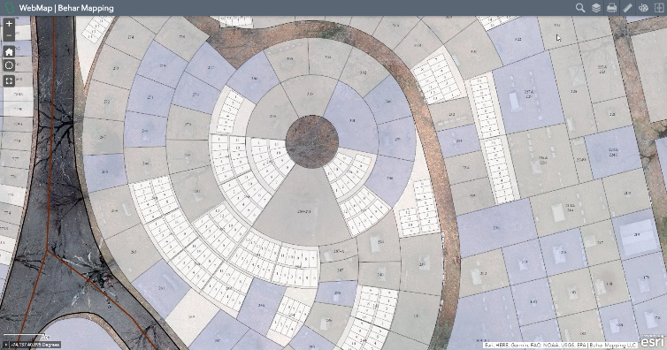
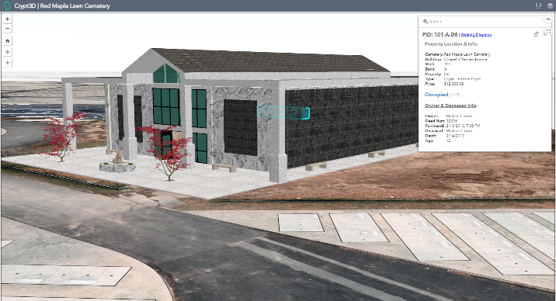
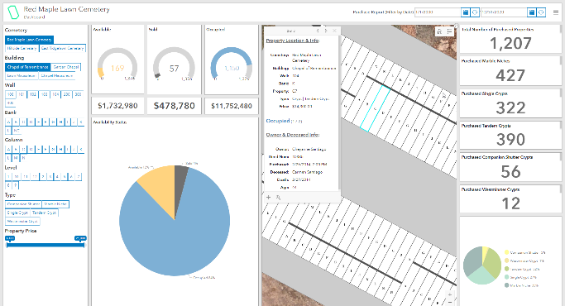
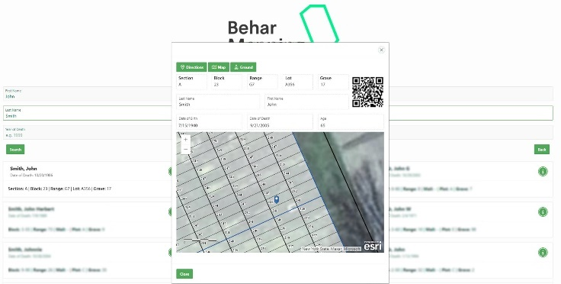
Products
Web-Map
Crypt3D
Dashboard
Kiosk

Slide 7
THANK YOU
61 Locust Lane, East Rutherford, NJ 07073 | Tel: 973-928-8718 | Fax: 973-778-0027 Email: info@beharmapping.com | www.beharmapping.com

