Slide 1
We didn’t miss a beat in 2021!

Slide 2
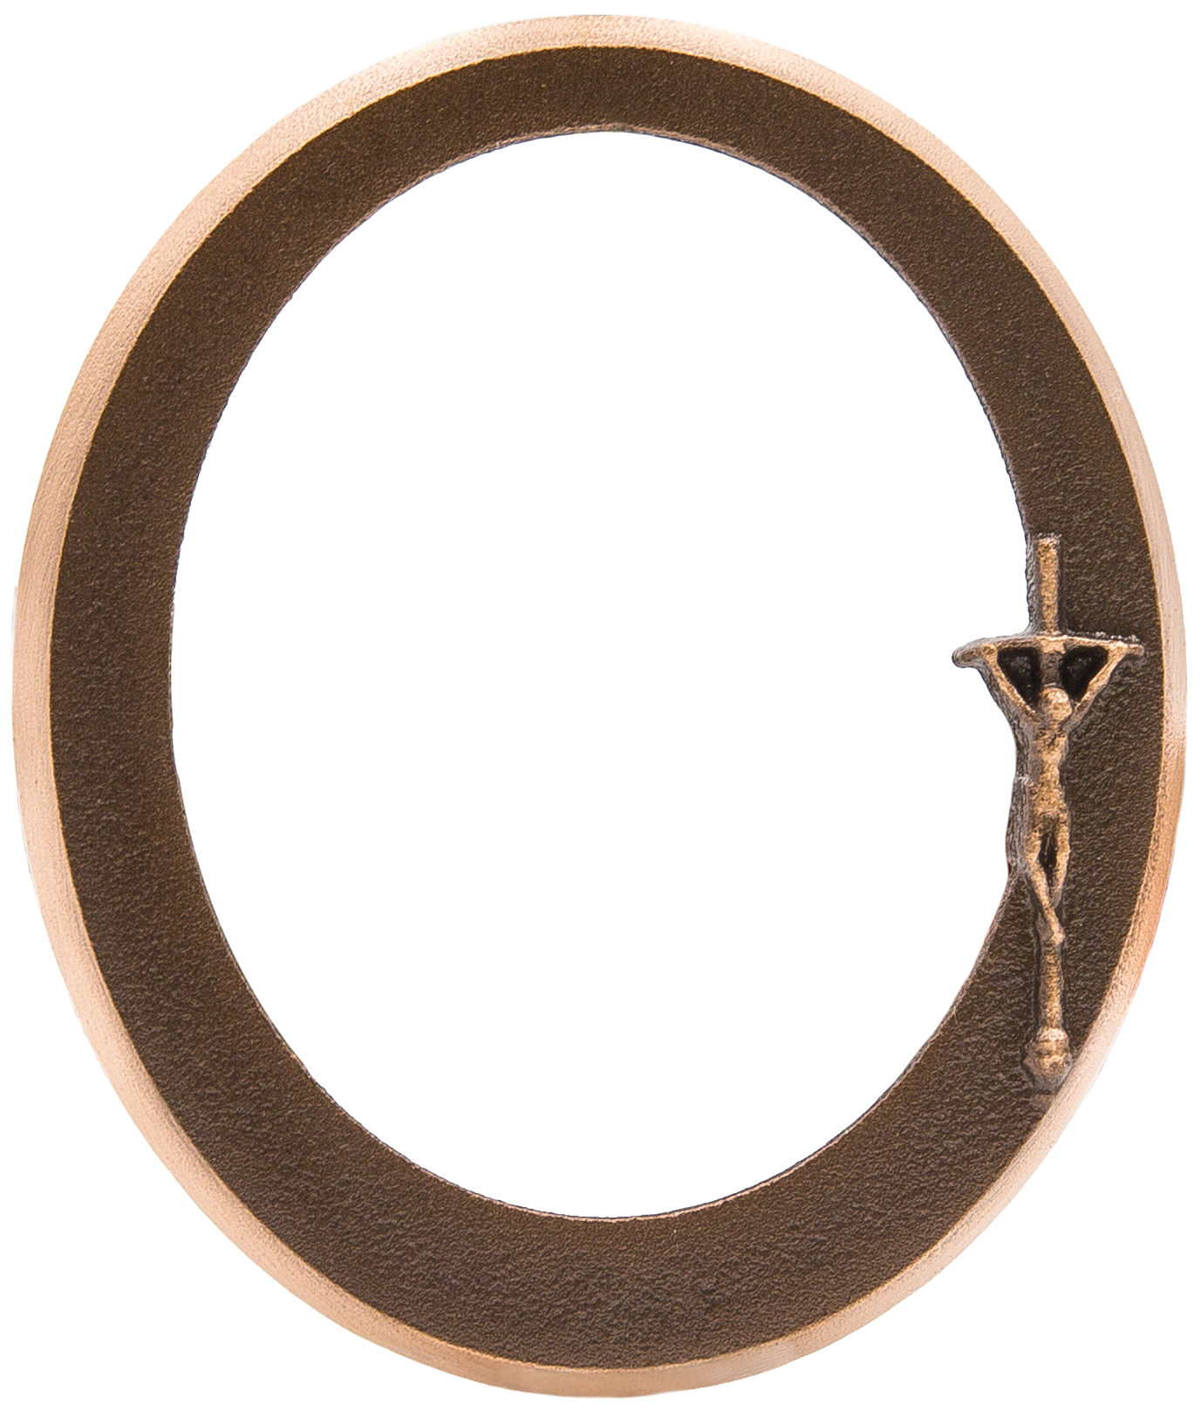
Frames
New in 2020!

Slide 3
Name Plaques

Slide 4
Thank you for your business in 2021

