Slide 1

ClearPoint Funeral & Cemetery Products
For Catholic Ministries

Slide 2

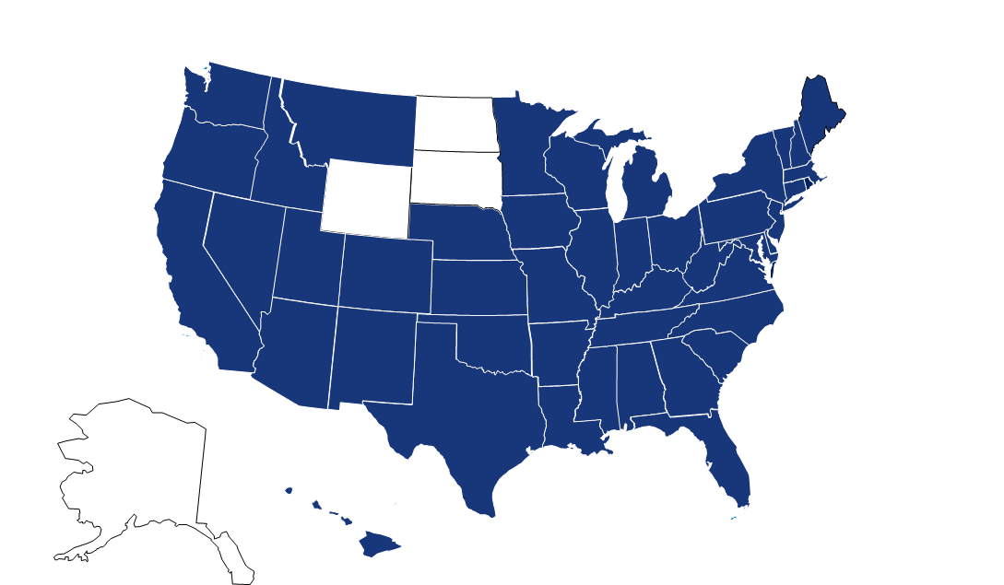

OVERVIEW
History
Relationships
Chartered in 1998 as Forethought Federal Savings Bank, a division of Hillenbrand Industries; has operated as an independently owned Bank since 2007
Headquartered in Batesville, Indiana
Over $1 Billion in Assets Under Management
Relationships with over 2,100 funeral homes and 200 cemeteries from small independent firms to the large publicly traded organizations
Over 20 years of experience with Catholic Services
Nationwide service with customers in
44 states
Nationwide service with customers in
44 states
Confidential and proprietary information of ClearPoint Federal Bank & Trust © 2020 ClearPoint

Slide 3
SUPPORTING YOUR MISSION
We offer guidance and provide best practices on how to set up your program, with regards to:
Trust Agreement/Protection of Funds
Trusting Amount/Deposits
Payment Terms
Cancellations/Distributions
Investment Approach
WE UNDERSTAND YOUR MISSION AND MINISTRY
Confidential and proprietary information of ClearPoint Federal Bank & Trust © 2020 ClearPoint

Slide 4

HEALTH ANALYSIS
Confidential and proprietary information of ClearPoint Federal Bank & Trust © 2020 ClearPoint

Slide 5



Thank You!
100 Progress Drive – PO Box 59, Batesville, IN 47006
800-763-0234
Customer.service@clearpointfederal.com
Clearpointfederal.com
Confidential and proprietary information of ClearPoint Federal Bank & Trust © 2020 ClearPoint

