Slide 1
Personalized and Custom Memorial and Building Solutions.

Slide 2
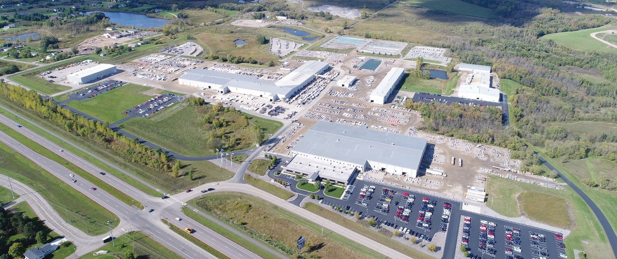
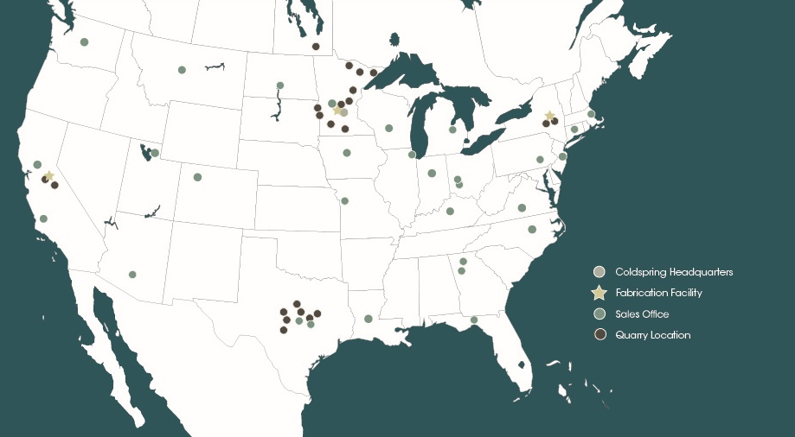
About Coldspring
Notes:
Coldspring is the largest granite quarrier in North America and is headquartered in Cold Spring, MN. Four additional fabrication facilities are located in Californina, Texas, New York and Canada, as well as 30 quarries across the country.
With more than 120 years of experience in the stone industry, several benefits of working with Coldspring include:
Quality – Coldspring is well-known for precision and excellence
Leveraging of automated technology – With their investment in technology, Coldspring produces products with exact precision and customization
Vertical Integration -- control of the material from extraction to completion provides benefits such as speed of fabrication and quality control

Slide 3
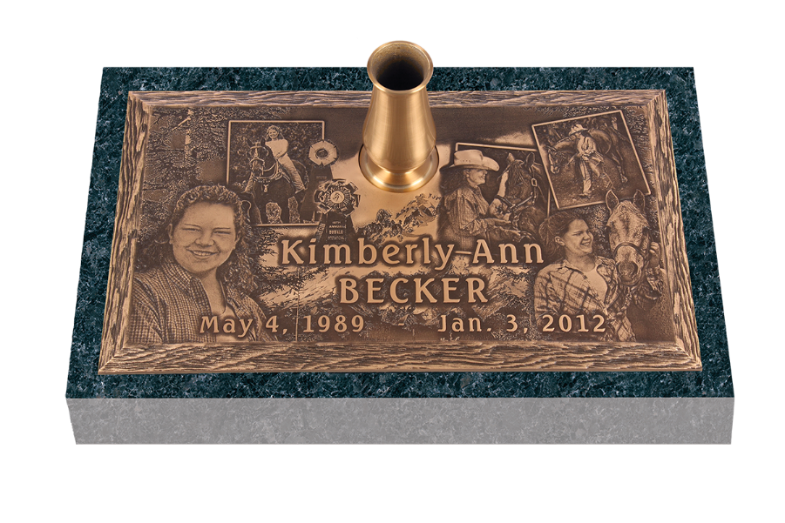
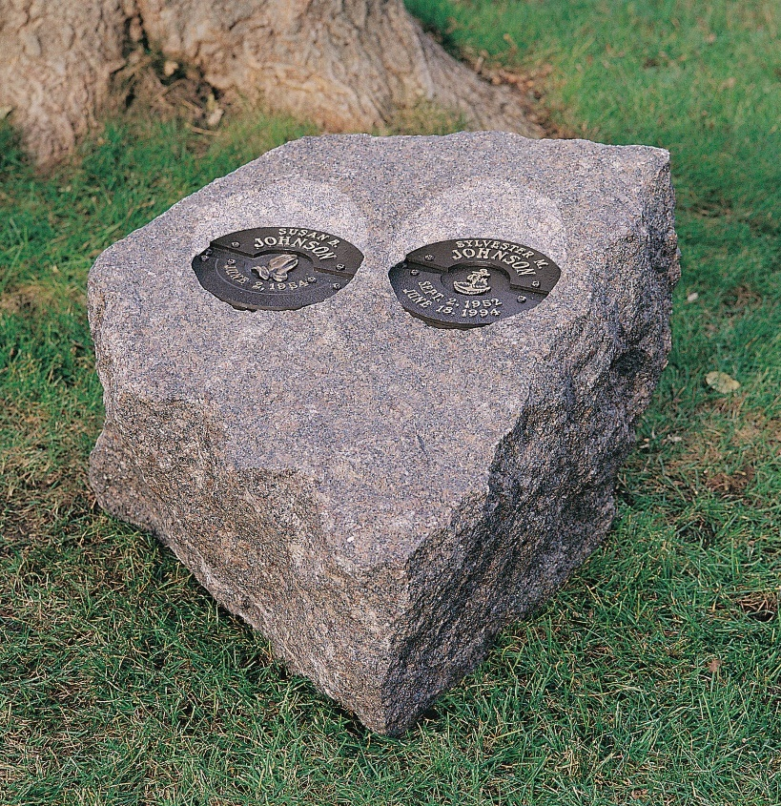
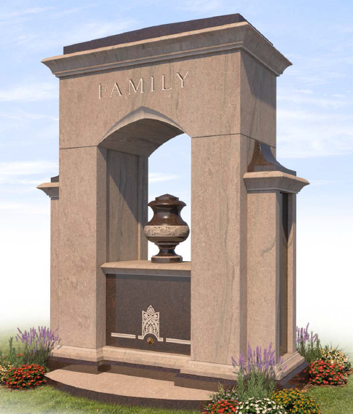
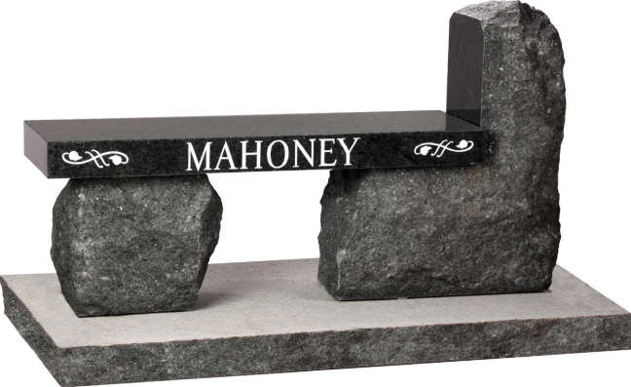
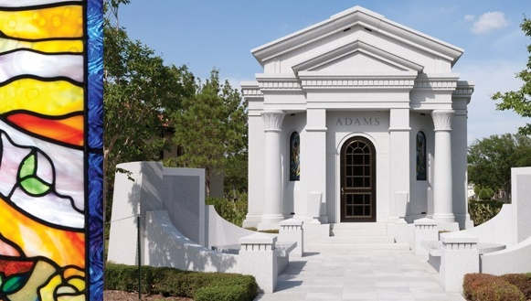
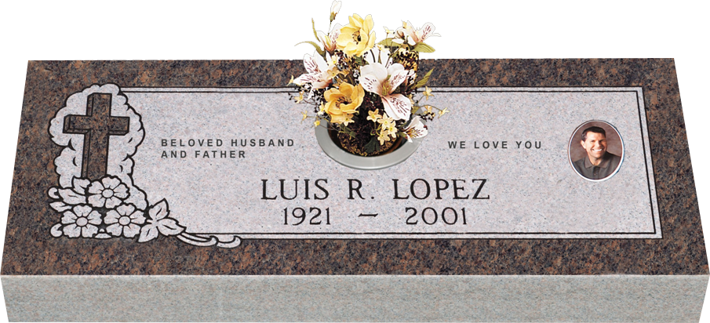
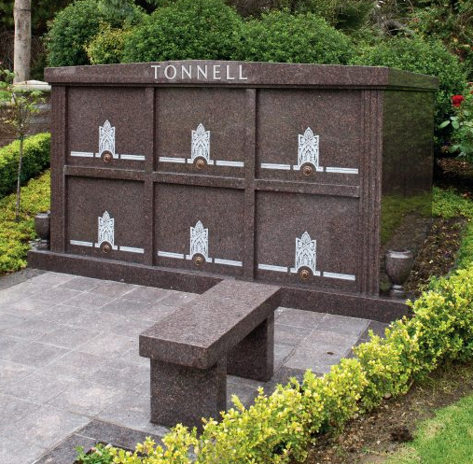
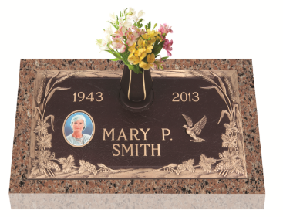
Endless Personalization Options
Notes:
INTENT OF SLIDE:
Educate the Family On All Their Options
Introduce one of the largest markets that Coldspring works in, deathcare with permanent memorialization. Coldspring’s Memorial division prides themselves on their quality, support and on-time delivery. Scope of products offered by Coldspring—see below.
MORE INFORMATION:
The memorial division includes construction & memorial products.
Construction: Private Estates®, Community Mausoleums, Columbaria, Restoration and Maintenance, Glass Niches, Cremation Gardens, Chapel Mausoleums, Funeral Homes, Administration and Maintenance Facilities
Memorial Products: Bronze Memorials, Granite Memorials, Cremation Memorials, Plaques & Signs, Expressions in Bronze®

Slide 4
Easy-to-Use Workflow
Real-Time Design Rendering
Quality Control & Proofing

Slide 5
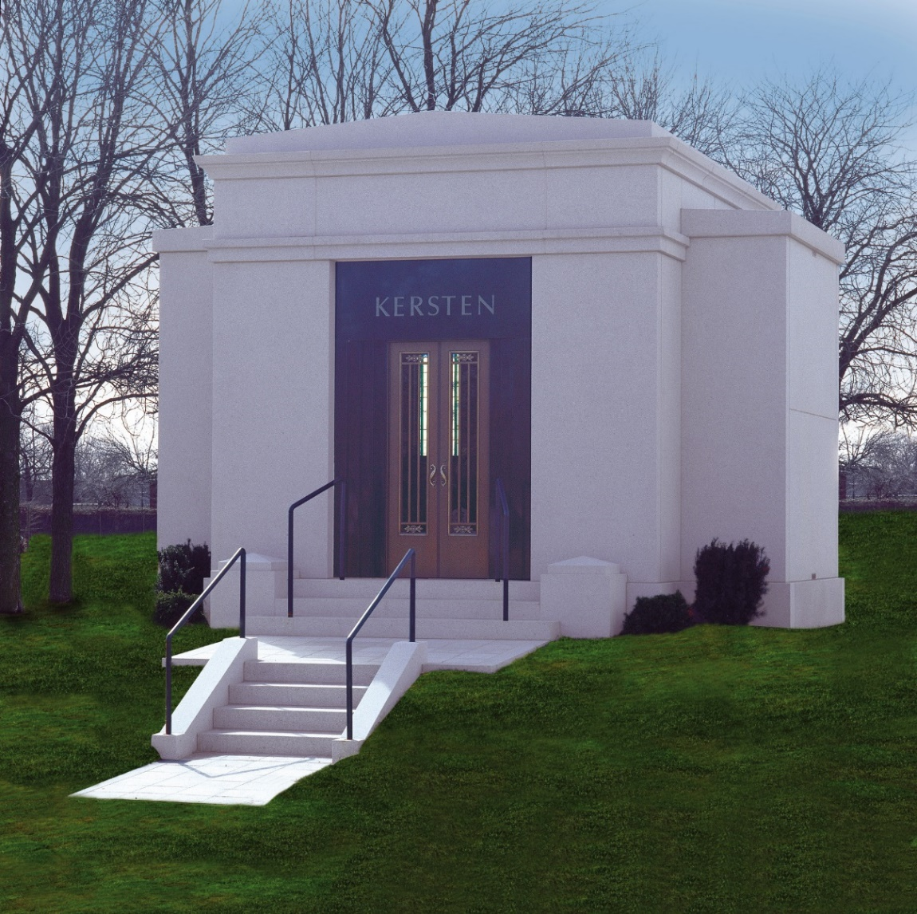
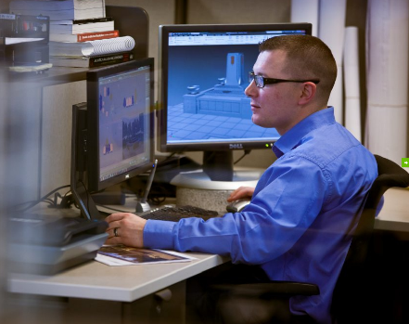
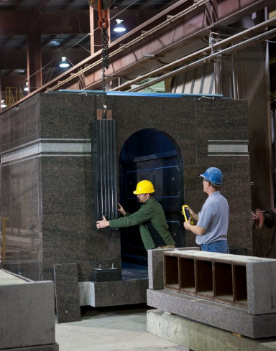
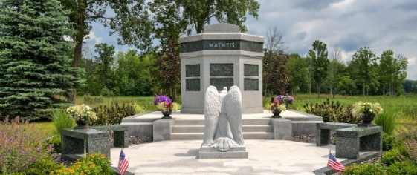
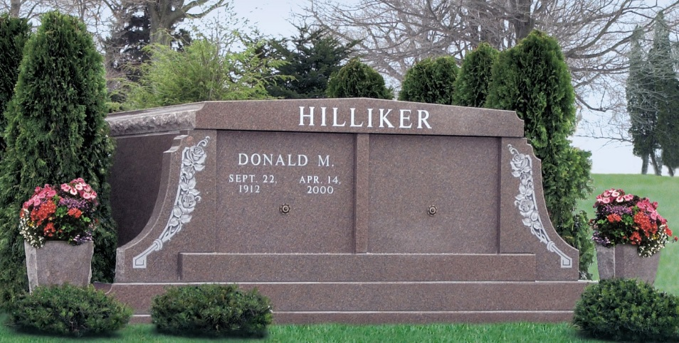
Private Estates®
Resources Start to Finish
Designers
Field Sales
Estimators
Project Managers
Customer Care
Site Development
Pre-need Speculation Program
Training
Notes:
INTENT OF SLIDE:
Coldspring can produce many different levels of design and sales aids including hand-drawings, renderings, computer models and 3D walk-through designs. Coldspring’s designers have all the tools to bring a high-end experience to high-end families, allowing the family to review and ensure it’s exactly as they had imagined.

Slide 6
THANK YOU
Dante Dugan
ddugan@coldspringusa.com
Dave Petermeier
dpetermeier@coldspringusa.com
Johnny Phillips
jtphillips@coldspringusa.com
coldspringusa.com | 800.328.5040

