Slide 1
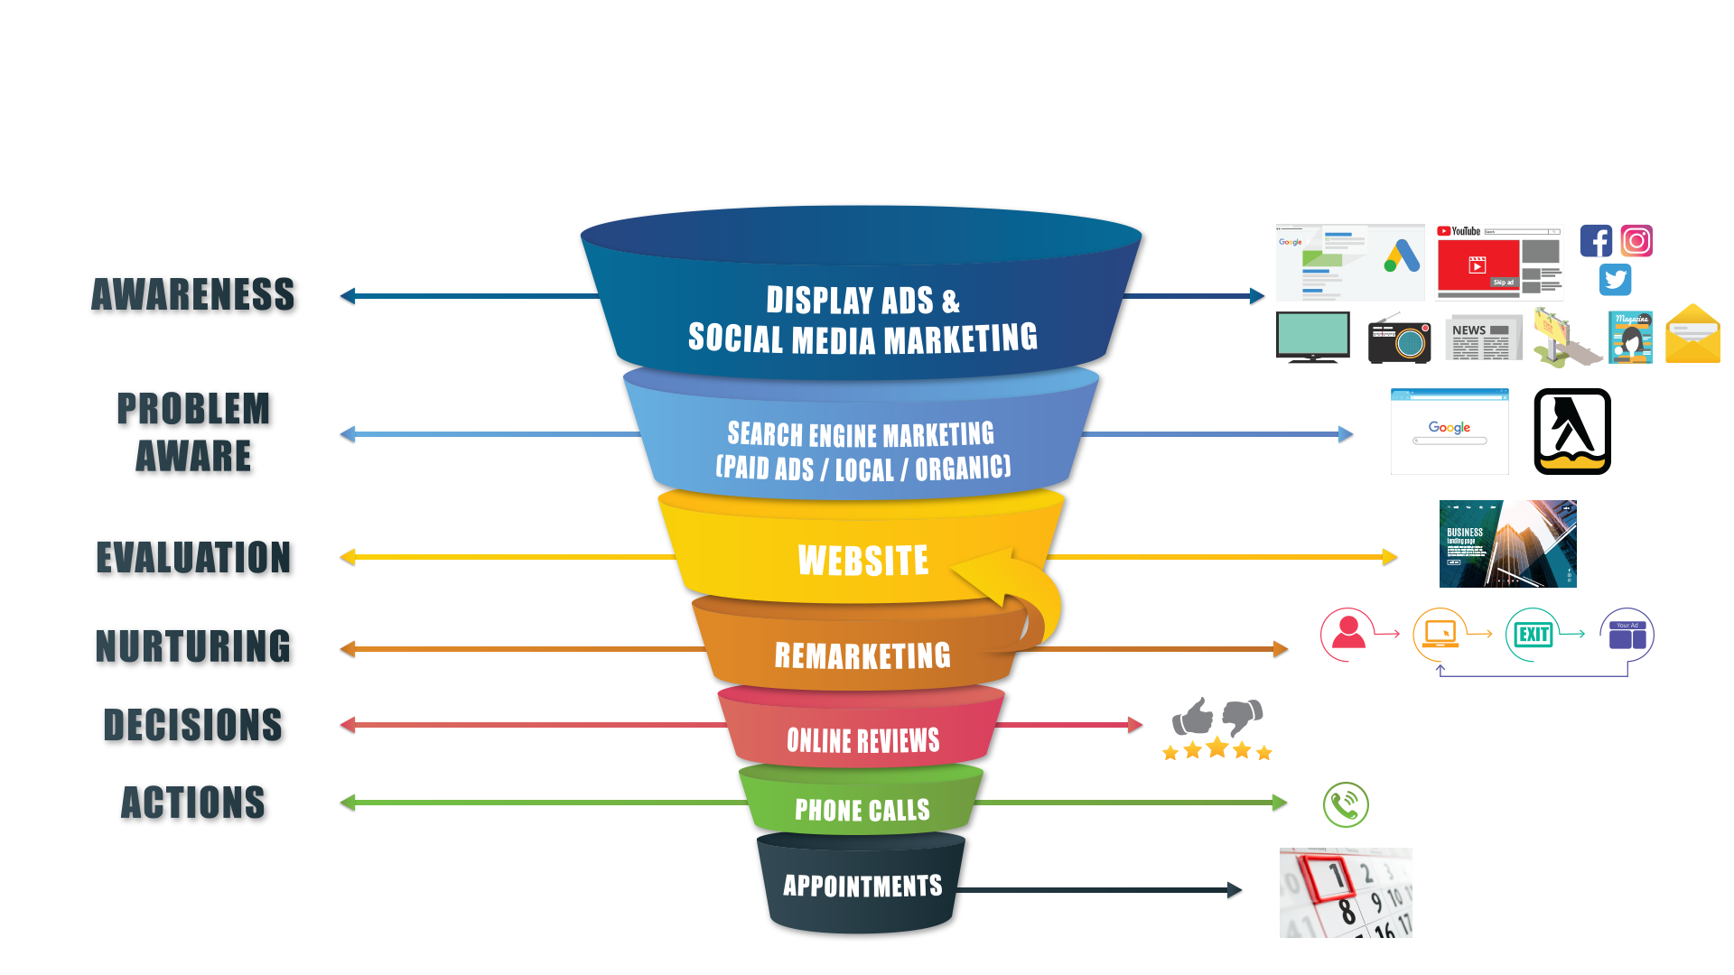
Problem Aware Journey (At-Needs)

Slide 2
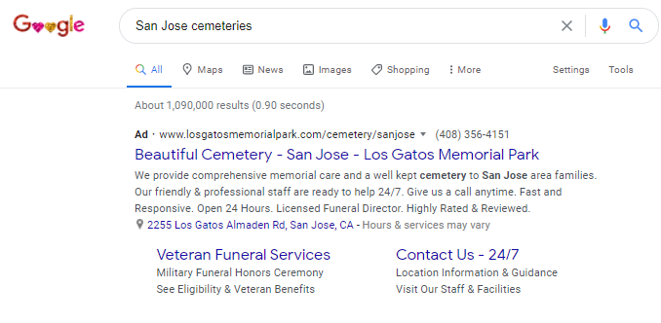
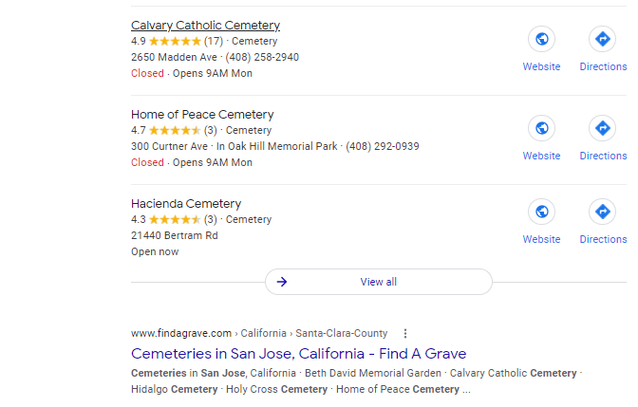
Three Types of Marketing
Pay-Per-Click
Advertising
Local
Business
Search
Organic
Search

Slide 3
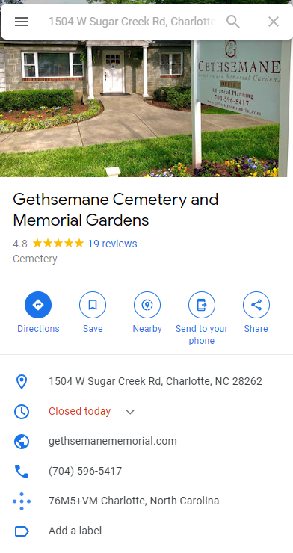
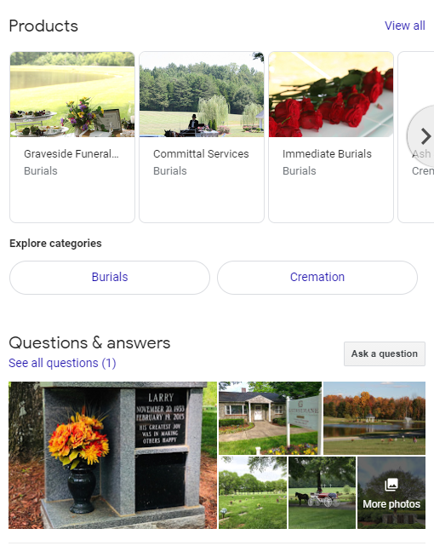
Google Listing

Slide 4
Intent Based Branding

Slide 5
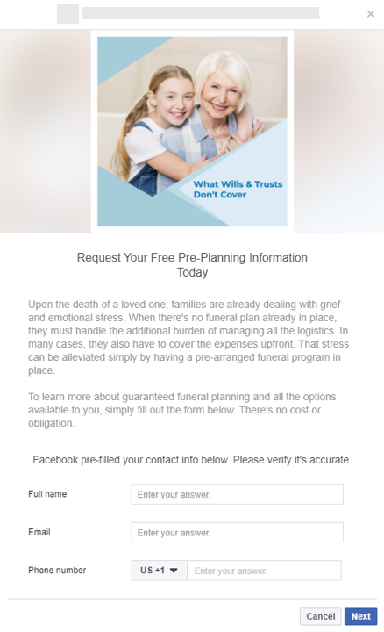
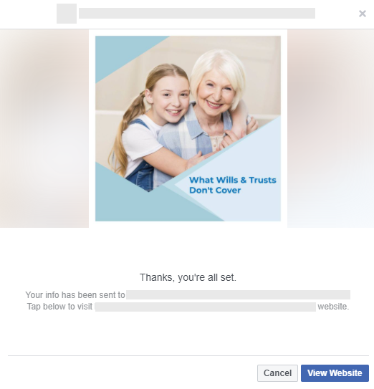
Lead Form Consumer Journey
4 Step Process - Produces Leads With Reduced Friction
TC Privacy
Thank you
Ad
Form
Lead
Notification
This document is confidential and may not be distributed without written consent of Ring Ring Marketing.

